Slide 1



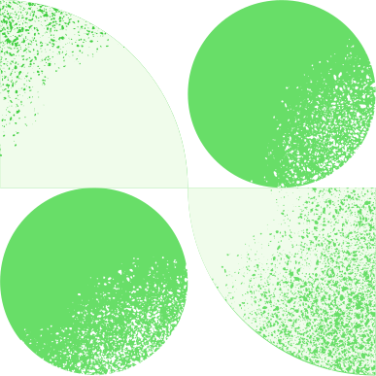
Startup
Minerva BI
Phone
Address
+994 50 555 89 54
16/21 Azadlıq Prospekti, Bakı

Slide 2



Table of Contents
About Us
Problem Statement
Solution
Competitor Analysis
Thank You

Slide 3


About
Us
NIFTALIYEV YUNIS
Founder & Data Analyst of MinervaBI
Email: niftaliyev_yunis@outlook.com
LinkendIn: Niftaliyev Yunis
GitHub: NIftaliyev Yunis

Slide 4


Problem
Statement
Direct & Impactful
Emotional Appeal
Comparative Framing
📊 80% of small businesses don’t use data to make informed decisions.
💸 Most rely on gut feeling instead of insights.
📉 This leads to missed opportunities, wasted marketing budgets, and declining profits.
Running a small business is hard.
Decisions feel like guesses.
MinervaBI gives small businesses clarity, confidence, and control.
Big companies have full analytics teams and expensive BI tools.
Small businesses? They get by with Excel and hope.
MinervaBI levels the playing field — making powerful analytics simple and affordable.

Slide 5




Solution
Clear and Concise
Value Proposition
📈 It collects your sales, marketing, and customer data — all in one place.
📊 Generates clear dashboards and reports.
No technical skills required. Just plug in — and see the numbers that matter.
✅ Save time — no more manual reports
✅ Increase profits — understand what drives your revenue
✅ Reduce risks — get alerts when key metrics drop

Slide 6
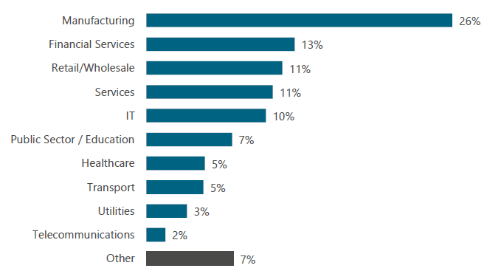
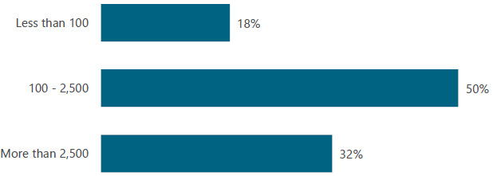
Data Analysis
1)Organization sizes by headcount
2)Vertical markets
Business intelligence and analytics products are most commonly found in midsize and large organizations. 82% of the responses we received came from users in companies with more than 100 employees.
We asked all respondents their company’s industry sector. The chart shows the results of this question and only includes data from respondents who answered product-related questions in The BI & Analytics Survey.

Slide 7
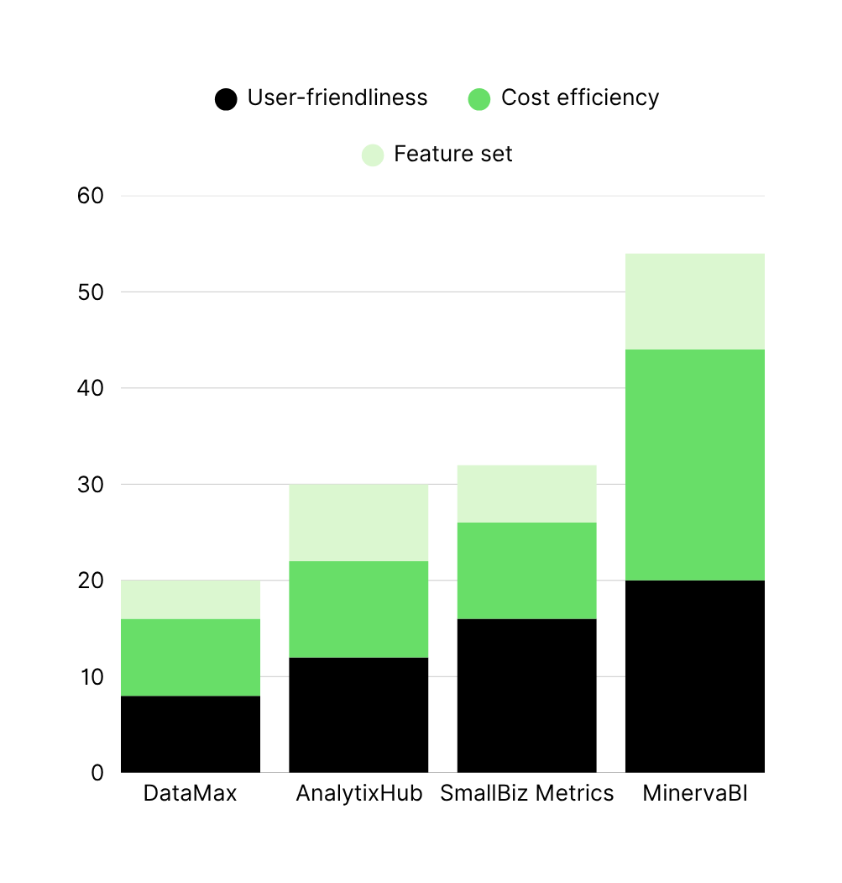

Competitor
Analysis
MinervaBI delivers the best balance of usability, affordability, and functionality — making data analytics accessible for small business owners.
Performance Metrics
This chart shows how MinervaBI outperforms competitors in key areas:
User-friendliness
Cost efficiency
Feature set

Slide 8

Thank You
For Your Attention!

